Slide 1
Tou Rate Study
Stakeholder meeting
Monday, April 15, 2024

Slide 2
Agenda
Introductions
TOU Study Requirements
AMI Deployment Update
Background on TOU rates
Charter
Discussion, Next Steps

Slide 3
Introductions
SPS Team
  Brooke Trammell
    Regional Vice President, Regulatory and Pricing
  Zoe Lees
    Regional Vice President, Planning and Policy
  Jeremiah Cunningham
    Manager, Rate Cases
  Alexander Trowbridge
    Manager, Pricing and Planning
  Stephanie Houle
    Assistant General Counsel
  Other key team members include:
    Mike Mally, Dolores Basquez, Jeff Comer, Jason Rurup, Miguel Cisneros, and Jane Aldakkour

Slide 4
Stakeholder Groups
Amarillo Recycling
Coalition for Clean Affordable Energy (CCAE)
Coalition for Community Solar Access (CCSA)
ConocoPhillips (COG)
ExxonMobil
Federal Executive Agencies (FEA)
Golden Spread Electric Cooperative (GSEC)
International Brotherhood of Electric Workers (IBEW)
Louisiana Energy Services (LES)
New Mexico Large Customer Group (NMLCG)
New Mexico Public Regulation Commission (NMPRC) Staff
NM Department of Justice (formerly NM Attorney General)
Occidental Permian (OPL)
Office of Public Utility Counsel (OPUC)
Orion
Public Utility Commission of Texas (PUCT)
Sierra Club
Texas Cotton Ginners Association (TCGA)
Texas Industrial Energy Consumers (TIEC)
Walmart
Western Resource Advocates (WRA)
Individual – Henry Janhsen

Slide 5
TOU Study requirements
Requirements for SPS
Collaboration with Interested Parties
The Scoping Process

Slide 6
Requirements for SPS
SPS will:
Commit reasonable efforts to collect the information and conduct the studies described in the scope of work;
Reasonably manage contractor costs;
Provide the results of the study to all parties participating in the scoping process;
Provide results based on an agreed upon schedule, but no later than the date of filing the next base rate case; and
Not oppose a filing requesting a Commission rulemaking to update Rule 550 and any relevant Commission forms to accommodate TOU fuel rates.

Slide 7
Collaboration with Interested Parties and Commission Staff
Determine the scope of work that would be necessary to develop and implement cost-based TOU fuel and base rates.
Scope of work includes process to gather information or conduct studies to enable parties to fully evaluate the impact of TOU fuel and base rates.
Present a TOU proposal to the collaboration group for evaluation and feedback.
Collaboration group will identify any potential barriers posed by Commission rules/forms to implementing TOU fuel and base rates.
TX 2023 Rate Case Final Order –states the NM study effort will be combined with the TX study effort

Slide 8
The Scoping Process
The Scoping Process will include:
at least two public workshops with the initial workshop no later than six months after issuance of a Final Order in the rate case.
creating a schedule for developing the scope of work to be agreed upon by the parties and SPS.
a date to complete information gathering and study work agreed upon by the parties and SPS once the scope of work is determined.

Slide 9
AMI Deployment Update
Grid Modernization approved – New Mexico
  NMPRC mandate to have AMI implemented in NM by May 2026; may need to start meter exchanges as early as September 2024.
  Project team is working to define project timeline including coordination with vendors
AMI Deployment – Texas
  Target Completion March 2025
  See next slide for progress and near-term forecast

Slide 10
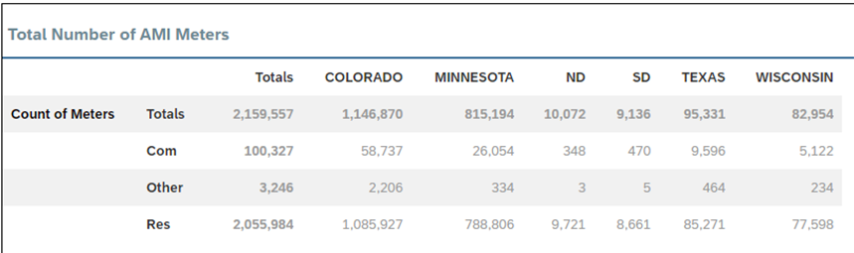
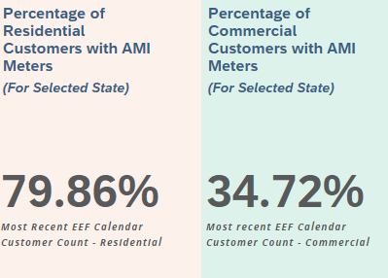
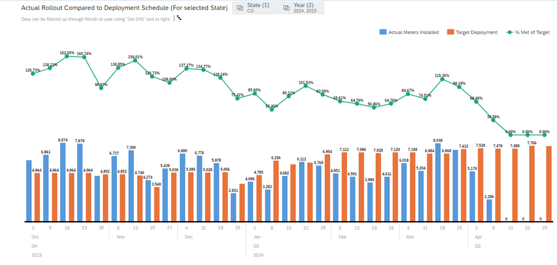
TX AMI Deployment Update

Slide 11

TOU Background & Considerations
Benefits of TOU Pricing
Key TOU Design Choices that Influence Impacts
Guidelines for Developing TOU Rates
  TOU Rate Considerations for Success
Choosing TOU Rate Periods
  System Load; Peak Hours & System Load Shapes
Common Types of TOU Rates
Criteria of a Desirable Rate
TOU Rates & Participation Today

Slide 12
Benefits of TOU Pricing
Time-of-use (TOU) pricing has several benefits, including:
Cost savings: TOU pricing offers the potential for cost savings by incentivizing customers to consume energy when the cost of generating electricity is cheap and to disincentive energy consumption when the cost of generating electricity is high.
Consumer empowerment: TOU pricing empowers consumers to take control of their energy usage and make informed decisions about when and how they consume electricity.
Grid stability: TOU pricing plays a crucial role in maintaining grid stability.
Sustainability: TOU pricing can contribute to a more efficient and sustainable energy landscape by encouraging the use of renewable energy sources.
Demand response: TOU pricing can help utilities manage peak demand and avoid blackouts by incentivizing customers to reduce their energy consumption during peak hours.

Slide 13
KEY TOU DESIGN CHOICES THAT INFLUENCE IMPACTS
The impact of time-based rates can vary widely. This variation is influenced by a number of important design dimensions*.
Peak/Off-Peak Price Ratio is one of the strongest predictors of customer peak load reduction. Higher ratios send a stronger price signal to shift consumption away from peak hours.
Peak Period Duration and Peak Period Frequency have a significant impact on customer acceptance. Customers are less willing to enroll in a rate, and less able to respond once enrolled, where the peak periods are too long or when critical peak pricing events occur too often.
The Financial Mechanism is a strong driver of peak load reduction. Price-based rates can double the reduction achieved with rebate-based rates, which reward conservation but do not penalize consumption.
The Enrollment Method affects customer acceptance, where opt-in rates attract more-engaged participants, but opt-out (default) rates have enrollment rates 3–5 times higher than opt-in rates, as well as increased peak reduction.
Enabling Technology can substantially increase the peak load reduction by customers. Rates coupled with “active” technologies (which automate customer response) reduce peak load by an additional 10–20 percentage points compared to the same rate without technology.
*Rocky Mountain Institute, www.RMI.ORG/ALTERNATIVE_RATE_DESIGNS, Published May 2016 – A Review of Alternative Rate Designs, P.6.

Slide 14
Guidelines for Designing TOU Rates
Well-designed TOU rates should reflect the cost of service
They often contain 2 or 3 pricing periods
In a 3-period rate, make sure that the mid-peak period rate equals or is slightly less than the standard rate
The rates may vary across weekdays and weekends, and/or vary seasonally
They may also vary seasonally
They may be offered on an opt-in or opt-out basis and, in rare cases, on a mandatory basis
https://energycentral.com/c/um/should-time-use-rates-be-made-standard-tariff
Faruqui, Ahmad PH.D. (2024). Moving Forward with TOU Rates: Addressing Regulatory, Utility and Customer Challenges [PowerPoint Slide 10]. Economist-at-Large, San Francisco, CA.

Slide 15
TOU Rate Considerations for Success
Provide meaningful savings opportunities
Have a short peak pricing period of no more than 5 hours
Offer choices to customers such as a 2-period and 3-period rates
Continue to offer a flat rate or a block-structure rate for those who don't want to be on a TOU rate
Consider offering a demand charge mixed in with TOU rates, it will help lower the energy charges
What price ratios should be offered on an opt-out (default) basis?
Between 2:1 and 3:1 is the ideal range
Faruqui, Ahmad PH.D. (2024). Moving Forward with TOU Rates: Addressing Regulatory, Utility and Customer Challenges [PowerPoint Slides 12-13]. Economist-at-Large, San Francisco, CA.

Slide 16

Choosing TOU Periods
System Dispatch Characteristics
Current Load Shape
Projected Future Load Shape
Integrated Resource Plan
Market Price Data

Slide 17
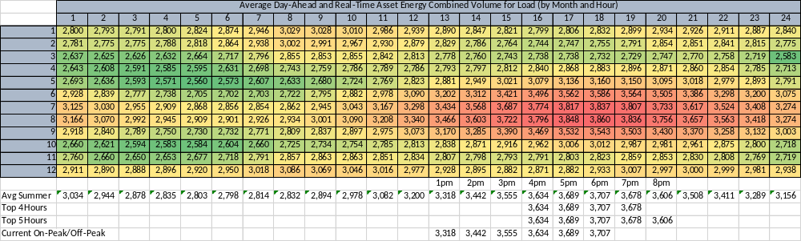
System Load – Heat Map – PEAK Hours

Slide 18
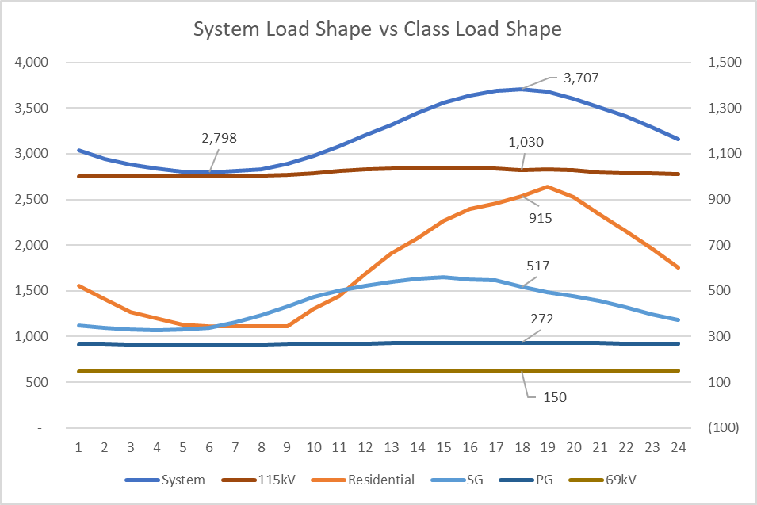
System Load Shape vs Class Load Shape

Slide 19
Common Types of TOU Rates
Simple Two-Period Rates
Three-Period Rates
Three-Period Seasonal Rates
Critical Peak Pricing (CPP)
Real-Time Pricing (RTP)
Alternative: Peak-Time Rebates (PTR)

Slide 20
Criteria of a Desirable Rate Structure
The principles of public utility rates, often referred to as the “Bonbright Principles,” are as follows:
Effectiveness in yielding total revenue requirements under the fair-return standard without any socially undesirable expansion of the rate base or socially undesirable level of product quality and safety.
Revenue stability and predictability, with a minimum of unexpected changes that are seriously adverse to utility companies.
Stability and predictability of the rates themselves, with a minimum of unexpected changes that are seriously adverse to utility customers and that are intended to provide historical continuity.
Static efficiency, i.e., discouraging wasteful use of electricity in the aggregate as well as by time of use.
Reflect costs in the provision of electricity (i.e., the internalization of all externalities).
Fairness in the allocation of costs among customers so that equals are treated equally.
Avoidance of undue discrimination in rate relationships so as to be, if possible, compensatory (free of subsidies).
Dynamic efficiency in promoting innovation and responding to changing demand-supply patterns.

Slide 21
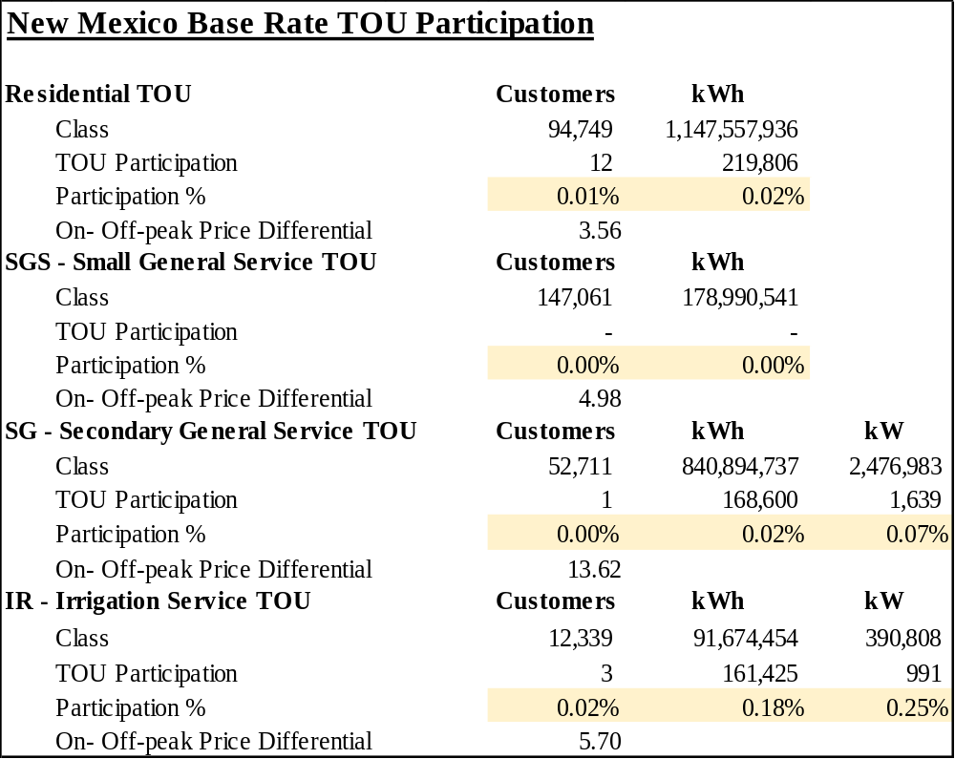
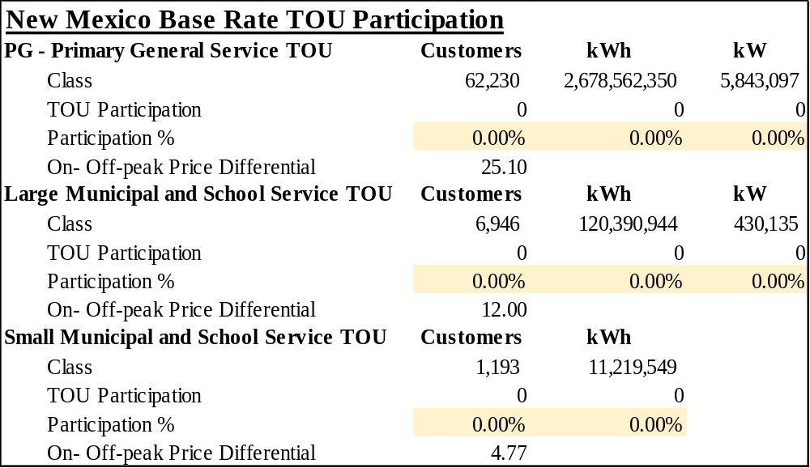
New Mexico Base Rate TOU Participation - Today

Slide 22
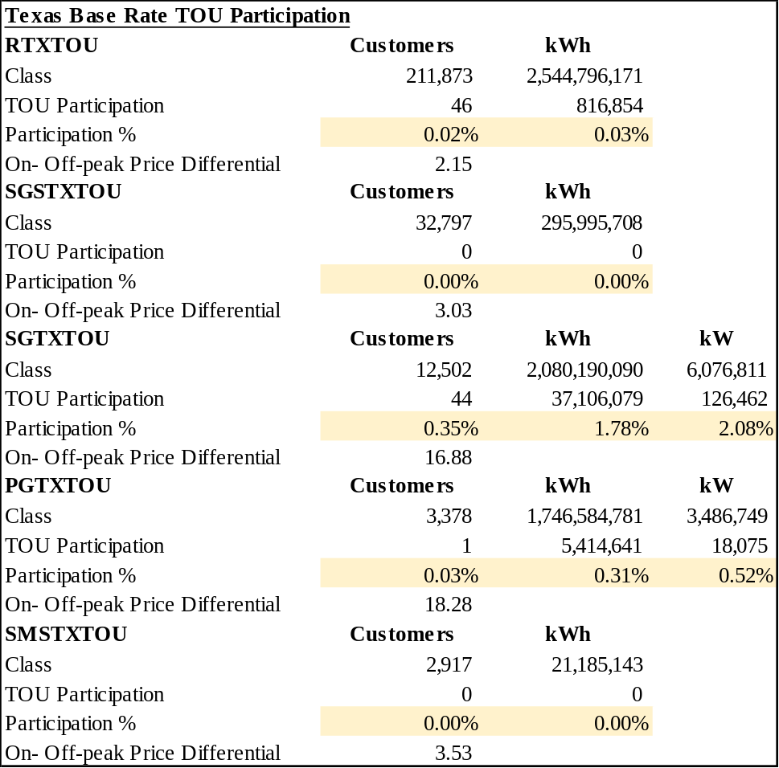
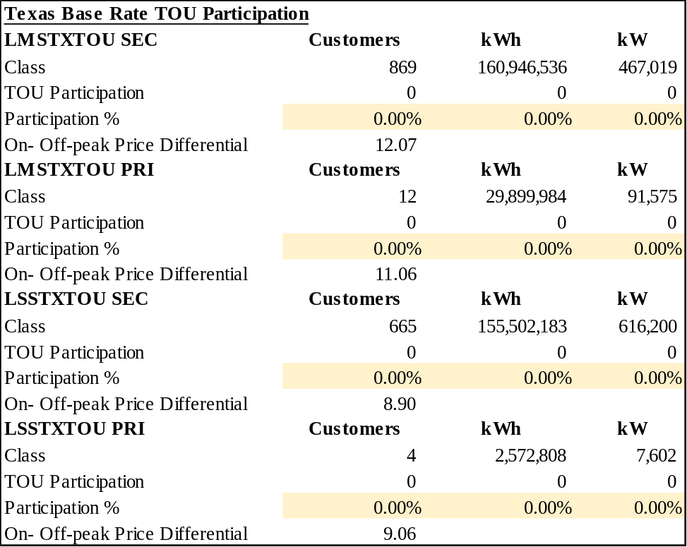
Texas Base Rate TOU Participation - Today

Slide 23
Charter –
Objectives of the TOU Study

Slide 24
Charter - Objectives of the TOU Study/Report
To support informed decision making, the study/report should provide an analysis of numerous existing studies, reports, and analyses to support an objective assessment of cost allocation, time-based rates and demand charge rates for customers.
The Study/Report should:
Provide a structure for utilities, regulators, and stakeholders to design and evaluate cost allocation, time-based rates and demand charge rates.
Identify technological or implementation constraints/costs
Identify rule or legislative constraints
Identify major design choices required for each rate, and reviews options for those dimensions.
Identify whether empirical data confirms (or refutes) the potential benefits of each rate, and notes where clear evidence is not available.
Highlights areas where further study is needed.

Slide 25
Next Steps

Slide 26
SPS’s Plan Moving Forward – Next Steps
Receive Stakeholder Feedback on Charter
Next Several Meetings - Develop Scope of Study
  Base Rate TOU & Fuel TOU
    Discuss individual classes – What are the Goals of Residential Rate Design vs Commercial?
    Discuss pricing signals
    Discuss time periods
    Discuss revenue sufficiency
    Discuss TOU rate structure (Simple Two-Period Rates, Three-Period Seasonal Rates, etc.)
    Discuss data and technological limitations
    Discuss rule/legislative limitations
  Feedback on existing TOU base rates
  Parties to weigh-in on whether a third-party consult should be obtained to facilitate the study
  Deliverables and timeline

